Slide 1
Short Story Assignment Presentation
Mayuri Lalwani | San Jose State University |
Masters in Data Science
Id:014637142

Slide 2
Text Generation for Floor Plans
A picture may be worth a thousand words but sometimes it’s the words that are most useful.

Slide 3
What is Image Captioning?
Process of generating textual description of an image
It comprises of two tasks:
Image understanding
Language generation components
Image understanding needs to detect and recognize objects
Language generation components require syntactic and semantic understanding of the language

Slide 4
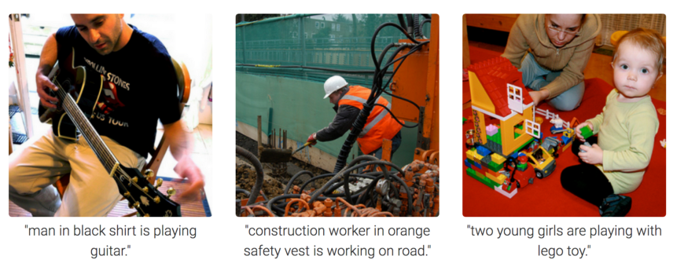
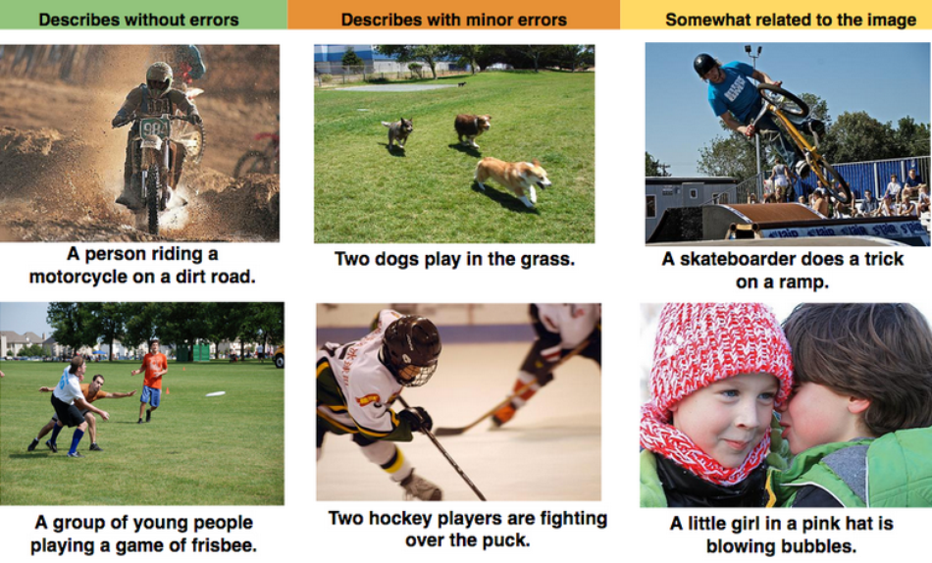
Some Examples of Image Captioning

Slide 5
Applications of Image Captioning
Helpful for visually impaired people
Social Media- Platforms like Facebook, Twitter can directly infer descriptions from images. The descriptions can include where we are, what we are doing and what we are wearing etc.
Automating the job of a person who interprets the image
Content based image retrieval can be applied in many area including biomedicine, commerce, military, education, digital libraries and web searching

Slide 6
Caption generation also has application in indoor path planning, real estate and providing architectural solutions
Only the captions are not sufficient to capture fine grain details we will discuss about two techniques which generates paragraphs from images
Description Synthesis from Image Cue(DSIC) model
Transformation Based Description Generation (TBDG) model

Slide 7
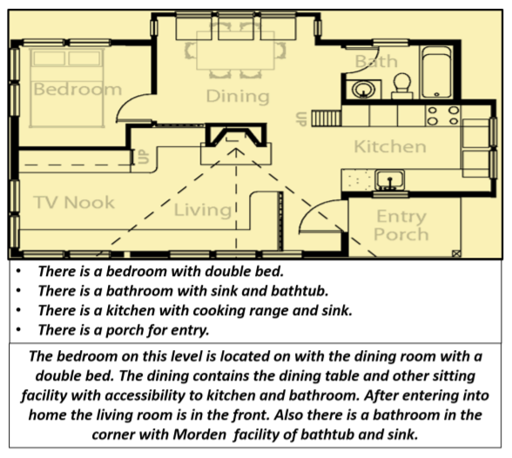
An illustration of the problem domain with the desired output

Slide 8
DSIC vs TBDG approach
The difference in both the models is the way they take input from the floor plan image
The DSIC model takes only visual features automatically extracted from deep neural networks
The TBDG model learns textual captions extracted from input floor plan images with paragraphs

Slide 9
Challenge:
A floor plan is in the form of a graphical document
It is not similar to natural photograph that has essential feature in every pixel. Therefore cues taken directly from images are not very efficient
The most popular choice for language modeling and text generation is encoder-decoder framework (CNN as encoder & RNN as decoder)
The research paper proposes multi staged pipeline using classical machine learning methods & generating textual descriptions by using semi structured sentence based model.

Slide 10
Uniqueness of the model
All visual information from floor plan images and textual features are learned together in an end to end deep learning framework and a holistic description of the same is generated

Slide 11
DSIC model
In this model, RPN (Region proposal Network) act as an encoder and hierarchical RNN act as decoder
One RNN is used to learn sentence topic vectors(S-RNN) from the pooled features. The other is used to learn words for respective sentence topic vectors(W-RNN)
CNN plus RPN are used to generate region proposals
Top 5 region proposals are pooled into single pooling vector
The pooled vectors are fed to S-RNN for each image and paragraph
Each input generated 5 sentences and 60 words
The output of S-RNN is given as input to W-RNN which generates words in each sentence

Slide 12
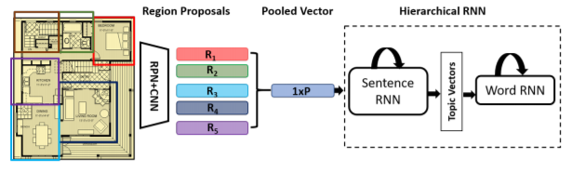
Hierarchical RNN to yield paragraph from floor plans

Slide 13
TBDG model
TBDG is a transformer based model which gives the entire input sequence to the decoder
Here the encoder is the Bi-LSTM unit and the decoder is the LSTM network with 256 unit
RPN learns region wise captions from dataset and generates a paragraph based description instead of multi sentenced paragraph
The data is in the tuple format(I,We,K) where I is the image of the floor plan, We is the word cues and K is the paragraph description about the floor
The top 5 captions with highest probability are selected and merged as one dimensional vector to generate paragraph description for floor plan

Slide 14
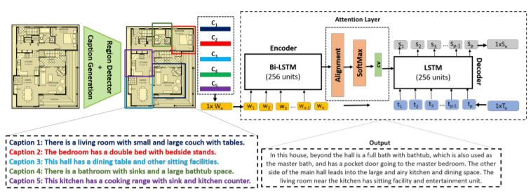
Framework of proposed TBDG of generating paragraph description from input floor plan

Slide 15
Professor Vijay – Thank you for your guidance
Reference links:
Survey Paper: https://arxiv.org/pdf/2103.08298.pdf
https://www.aclweb.org/anthology/W14-1602.pdf

Slide 16
Thank you!

